Slide 1
Dr. Swapna Dutta
HoD, Dept . Of Home Science

Slide 7
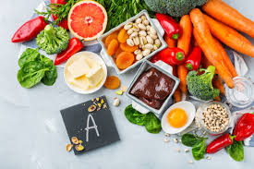
FOOD SOURCES OF VITAMIN -A

Slide 8
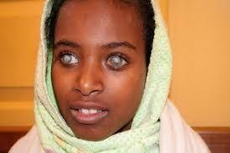
DEFICIENCY OF VITAMIN-A

Slide 9
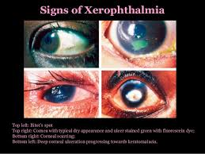
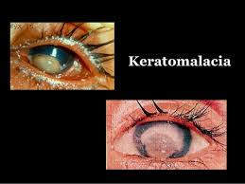

Slide 10
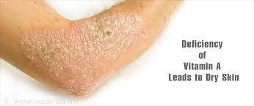
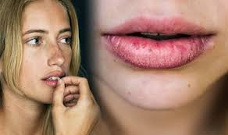

Slide 11
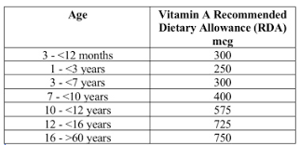

Slide 12
THANK YOU

